Slide 1
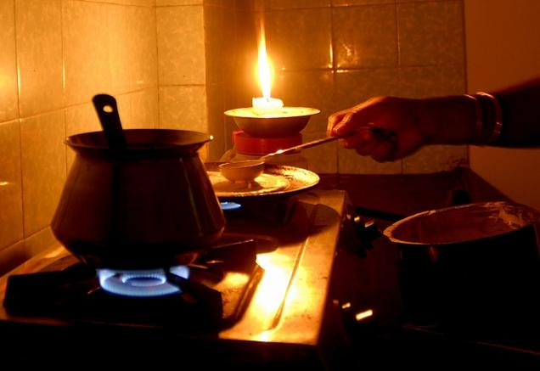
July 2012 India blackout was the largest
power outage in history

Slide 2
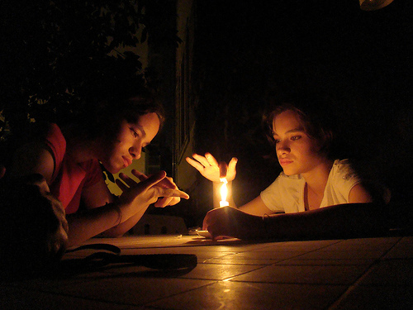
In December 2011, over 300 million Indian citizens had no access to electricity

Slide 3
By 2030, India's dependence on energy imports is expected to exceed 53% of the country's total energy consumption

Slide 4

What if we can save the Energy without compromising our Economic Future!

Slide 5
Can One Activity be So Effective That It

Slide 6

Can save the energy & also maintain the level of performance?

Slide 7
SHILPI TANDON (3551)
ROHIT CHAWLA(3532)
AND
SAYYAM SACHDEV (3545)
Of G – 34
Presents

Slide 8
CPU-MISER

Slide 9
The
IDEA

Slide 10
Performance and power are critical design constraints in today’s high-end computing systems
We present a runtime system (CPU MISER) and an integrated performance model for performance-directed, power-aware cluster computing.
CPU MISER supports system-wide, application independent, fine-grain, dynamic voltage and frequency scaling (DVFS) based power management for a generic power-aware cluster. Experimental results show that CPU MISER can achieve as much as 20% energy savings for the NAS parallel benchmarks.

Slide 11
Today’s high-end systems deliver incredible peak performance but consume tremendous amounts of electric power. This amount of power consumption can result in operating costs that exceed acquisition costs. The heat generated can elevate ambient temperature and increase failure rates.
Reducing the power consumption of these systems is necessary, but reducing performance substantially is unacceptable.
Have shown that clever scheduling of CPU power modes using dynamic voltage and frequency scaling (DVFS) can save significant amounts of total system energy for parallel applications.

Slide 12
Fast Growing Power Consumption
in Super Computers
700%
300%

Slide 13
Background

Slide 14
DVFS is a method through which variable amount of energy is allocated to perform a task
Power consumption of a digital CMOS circuit is:
P = α . C_{eff} . V² . F
α : switching factor
C_{eff} : effective capacitance
V : operating voltage
f : operating frequency
Energy required to run a task during T is:
E = P⋅ T ∝ V² (assuming f ∝ V, T ∝ (f –1))
Lowering V (while simultaneously and proportionately cutting f) causes a quadratic reduction in E

Slide 15
Design and efficiency

Slide 16
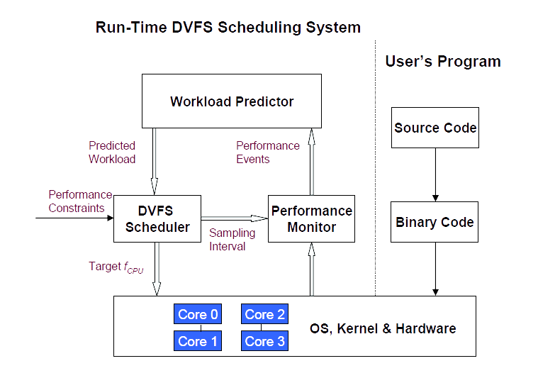

Slide 17
Our primary design constraint will be the user's interaction with the Linux Operating system.
CPU MISER vary significantly for different benchmarks.
For codes with large amounts of communication and memory access, CPU MISER can save up to 20% energy with 4% performance loss. For codes that are CPU-bound (e.g., EP), CPU MISER saves little energy since reducing processor frequency would impact performance significantly.
DVFS scheduling in high-performance computing. To achieve optimal energy-performance efficiency, the rigorous theoretical analysis used in CPU MISER is necessary for scheduler design.

Slide 18
Energy Saving

Slide 19
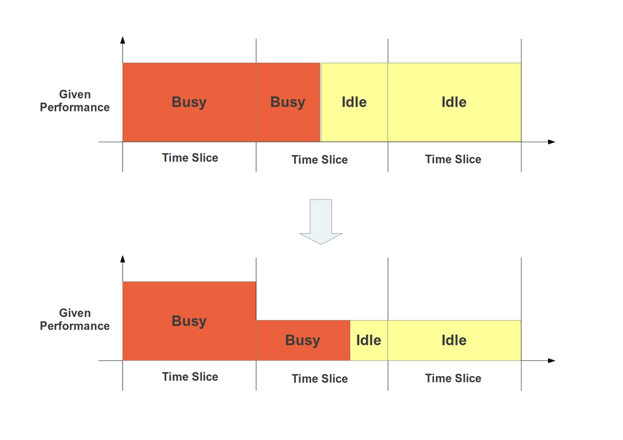

Slide 20
System Modelling / Architecture

Slide 21
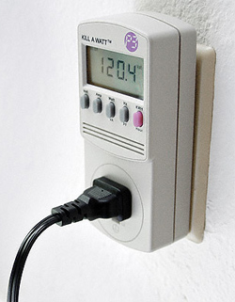
With the help of
&&clause :
DVFS Scheduling + NAS Parallel Benchmark are executed
Kill –a-Watt
Power
Meter
CPU

Slide 22
Constraints / Limitations

Slide 23
Our primary design constraint will be the user's interaction with the Linux Operating system.
The major obstacle is the hardware limitations. Our project code or the source code for CPU-MISER varies with the CPU Specifications especially the number and range of P states which is the biggest limitation in our project.

Slide 24
Future Work

Slide 25
Our experimental results show that NPB benchmarks save up to 20% energy when using CPU MISER as the DVFS scheduler and that performance loss for most applications is within the user-defined limit. This implies that the methodology we presented in this paper is promising for large-scale deployment. We attribute these results to the underlying performance model and performance-loss analysis. However, we also note that further tuning for CPU MISER is possible and the subject of future work.
Given that CPU MISER is built upon a generic framework and is transparent to both users and applications, we expect that it can be extended to many power-aware clusters for energy savings. In the future, we will refine the run-time parameter derivation and improve the prediction accuracy. We will also further investigate the impact of CPU MISER on more architectures and applications.

Slide 26
Timeline of Implementation

Slide 27
PHASE I:
Initiation of project
Finding research papers & preparation of synopsis
PHASE V:
Demonstration Of Final Project
PHASE IV:
Verification of the implementation of Code by taking output on a
Kill a-Watt Power Meter
PHASE II:
Preparation of SRS,
Presentation and Submission of Research Papers
PHASE III:
Implementation of code in C language on Ubuntu

Slide 28


